Slide 1
Before Class…
Please sit in groups of 4 or more for lecture today!
We are practicing voting strategies.

Slide 2
Announcements
Electronic assignment 12 due 4/30
Programming assignment due 5/2
Final exam 5/9 1-4pm (Rashid Auditorium)
You’re doing great!!!

Slide 3

AI: Representation and Problem Solving
Game Theory
Instructors: Pat Virtue & Stephanie Rosenthal
Slide credits: Ariel Procaccia, Fei Fang

Slide 4
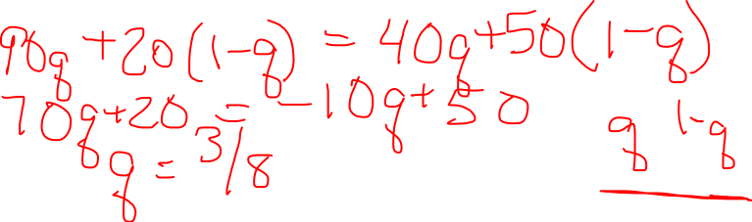
Mixed Strategy NE
P1
GAME OF THRONES |  | NIGHT KING
 |  | FLEE | FIGHT
HUMANS | FLEE | 90,10 | 20,80
 | FIGHT | 40,60 | 50,50
P2
Notes:
90q+20(1-q) = 40q+50(1-q)
70q+20 = -10q+50
80q = 30
q = 3/8
10p+60(1-p) = 80p+50(1-p)
-50p+60 = 30p+50
10 = 80p
P = 1/8

Slide 5
Other Properties of Strategies
Correlated Equilibrium
Pareto Optimal/Dominated

Slide 6
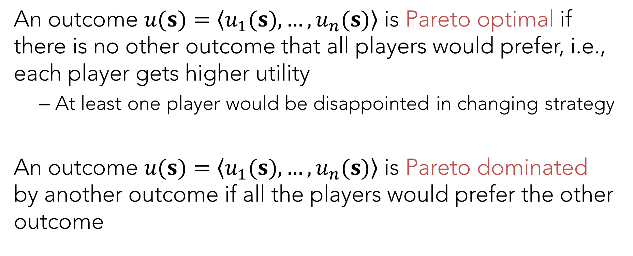
Pareto Optimal and Pareto Dominated
An outcome $u(s)=〈u_{1}(s),…,u_{n}(s)〉$ is Pareto optimal if there is no other outcome that all players would prefer, i.e., each player gets higher utility
At least one player would be disappointed in changing strategy
An outcome $u(s)=〈u_{1}(s),…,u_{n}(s)〉$ is Pareto dominated by another outcome if all the players would prefer the other outcome

Slide 7
Joint vs Independent Strategies
A mixed strategy NE is one where each player chooses his/her action independently from the other players.

Slide 8
Joint vs Independent Strategies
A mixed strategy NE is one where each player chooses his/her action independently from the other players.
TRAFFIC |  | CAR 2
 |  | STOP | GO
CAR 1 | STOP | 0,0 | 0,1
 | GO | 1,0 | -100,-100

Slide 9
Joint vs Independent Strategies
A mixed strategy NE is one where each player chooses his/her action independently from the other players.
PSNE 1: (STOP,GO)
PSNE 2: (GO,STOP)
MSNE 3:
TRAFFIC |  | CAR 2
 |  | STOP | GO
CAR 1 | STOP | 0,0 | 0,1
 | GO | 1,0 | -100,-100

Slide 10
Joint vs Independent Strategies
A mixed strategy NE is one where each player chooses his/her action independently from the other players.
PSNE 1: (STOP,GO)
PSNE 2: (GO,STOP)
MSNE 3: Stop: 100/101
Go: 1/101
TRAFFIC |  | CAR 2
 |  | STOP | GO
CAR 1 | STOP | 0,0 | 0,1
 | GO | 1,0 | -100,-100

Slide 11

Joint vs Independent Strategies
A mixed strategy NE is one where each player chooses his/her action independently from the other players.
PSNE 1: (STOP,GO)
U(STOP,GO) = (0,1)
PSNE 2: (GO,STOP)
U(GO,STOP) = (1,0)
MSNE 3:
-0.0001= 0(.99)(.99)+0(.99)(.01)
+ 1(.01)(.99)-100(.01)(.01)
TRAFFIC |  | CAR 2
 |  | STOP | GO
CAR 1 | STOP | 0,0 | 0,1
 | GO | 1,0 | -100,-100

Slide 12
Joint vs Independent Strategies
A mixed strategy NE is one where each player chooses his/her action independently from the other players.
0.01% of the time, we risk death with such a strategy!
What if instead we have a mediator who chooses among joint strategies? Does this produce a higher expected utility and higher social welfare?

Slide 13
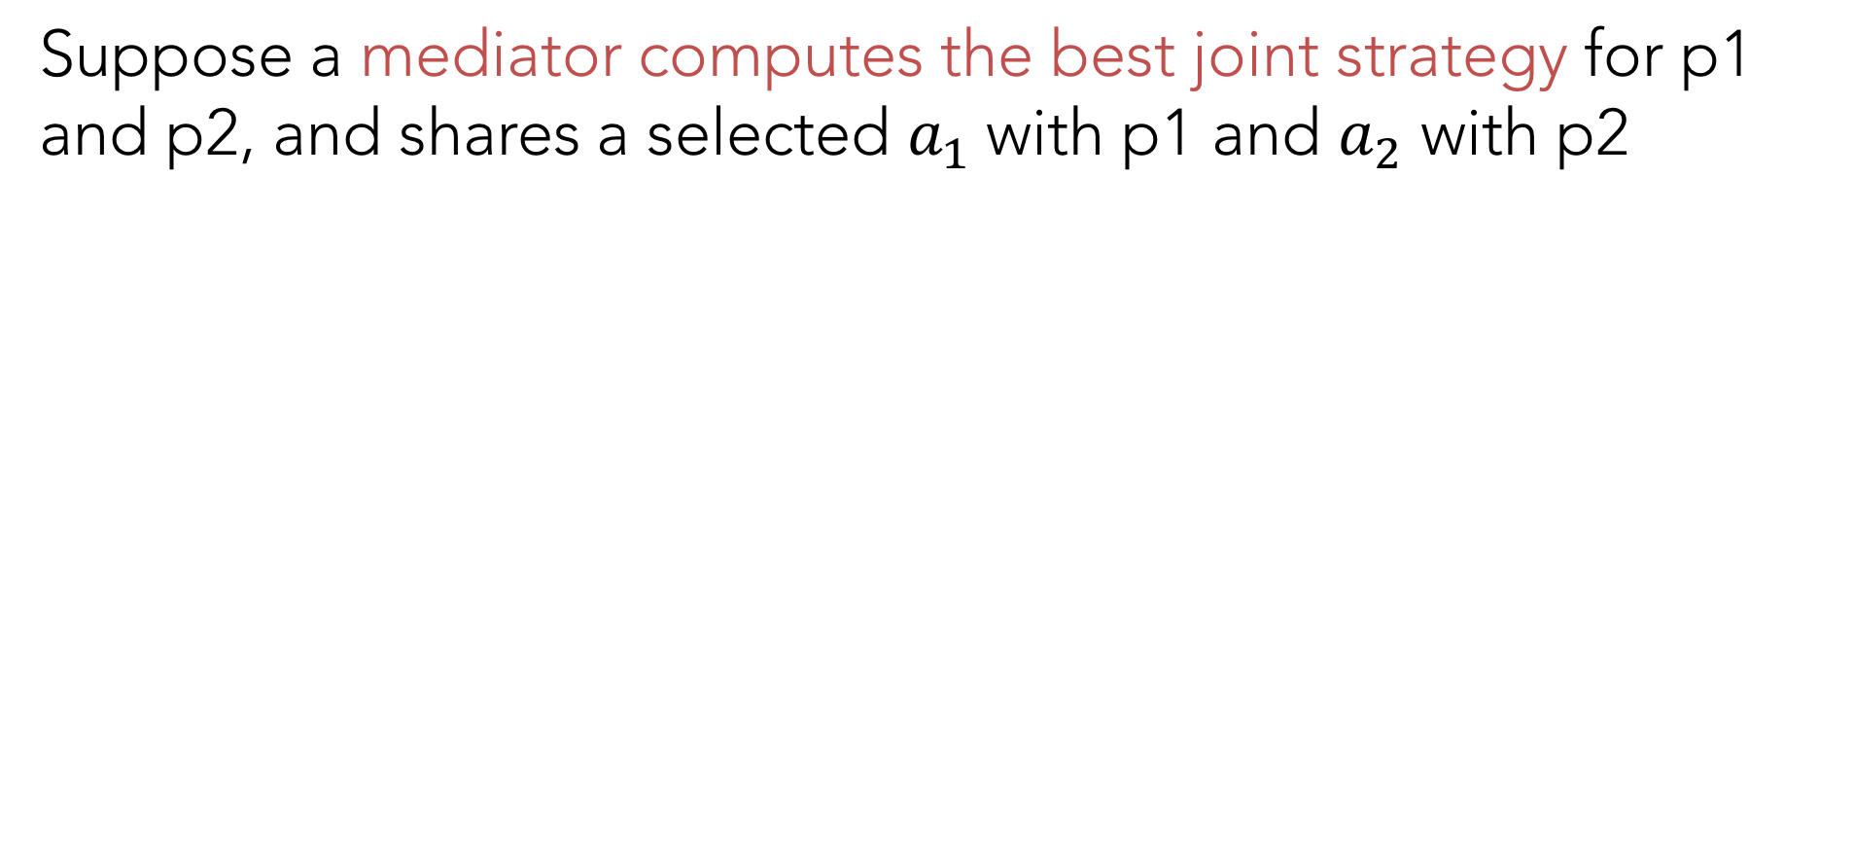
Correlated Equilibrium
Suppose a mediator computes the best joint strategy for p1 and p2, and shares a selected $a_{1}$with p1 and $a_{2}$ with p2
TRAFFIC |  | CAR 2
 |  | STOP | GO
CAR 1 | STOP | 0,0 | 0,1
 | GO | 1,0 | -100,-100

Slide 14
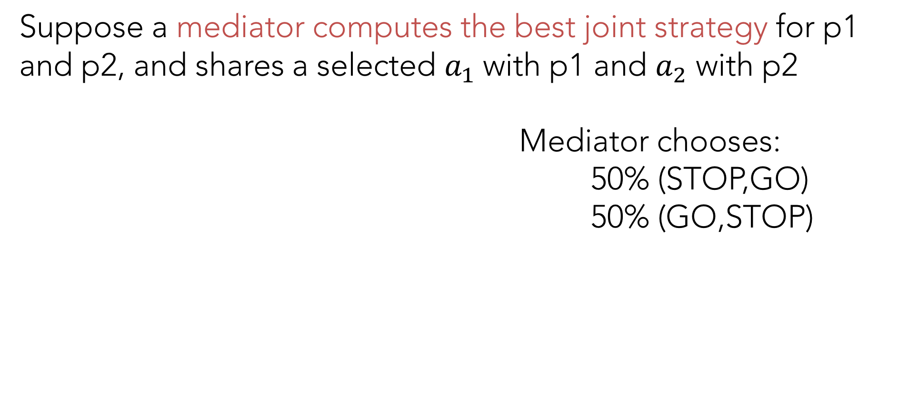
Correlated Equilibrium
Suppose a mediator computes the best joint strategy for p1 and p2, and shares a selected $a_{1}$with p1 and $a_{2}$ with p2
Mediator chooses:
50% (STOP,GO)
50% (GO,STOP)
TRAFFIC |  | CAR 2
 |  | STOP | GO
CAR 1 | STOP | 0,0 | 0,1
 | GO | 1,0 | -100,-100

Slide 15

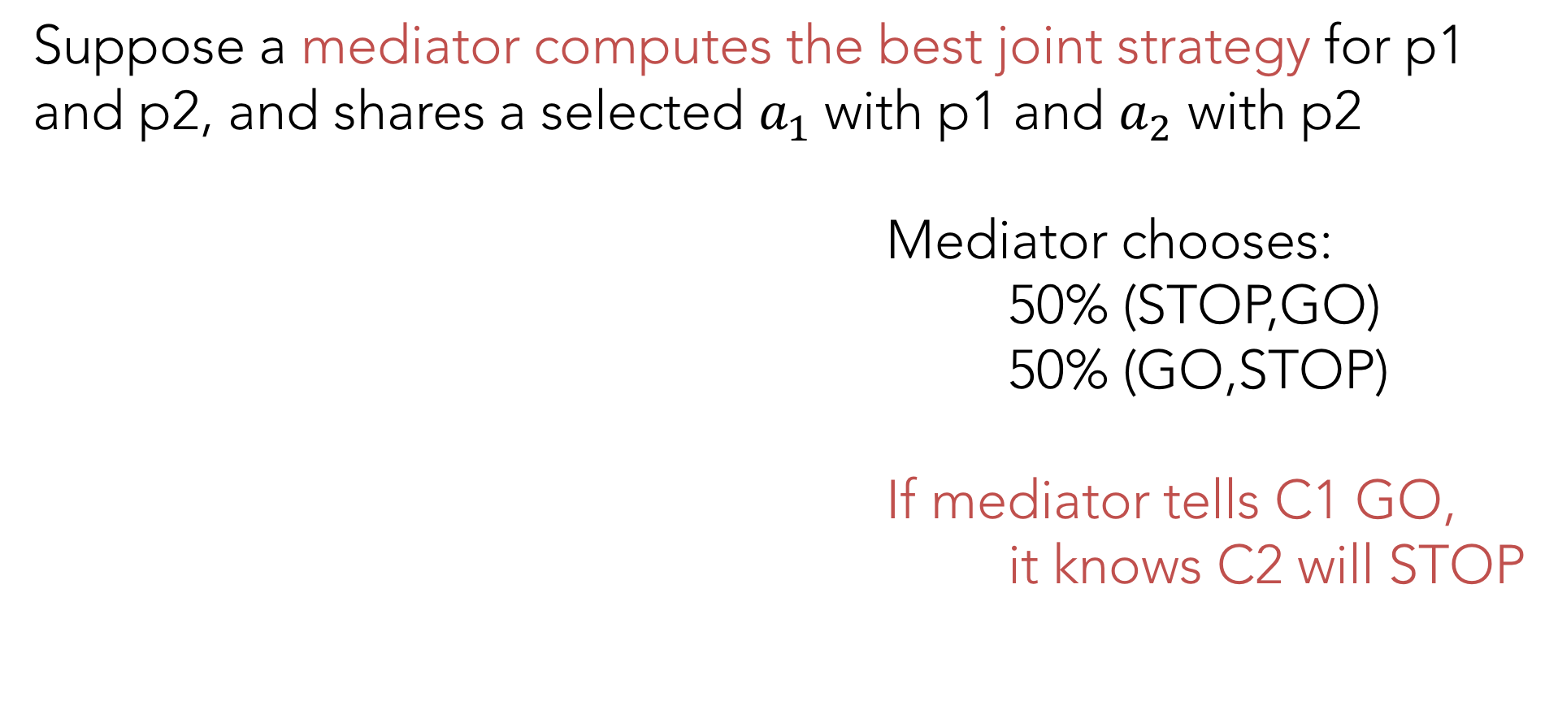
Correlated Equilibrium
Suppose a mediator computes the best joint strategy for p1 and p2, and shares a selected $a_{1}$with p1 and $a_{2}$ with p2
Mediator chooses:
50% (STOP,GO)
50% (GO,STOP)
If mediator tells C1 GO,
it knows C2 will STOP
TRAFFIC |  | CAR 2
 |  | STOP | GO
CAR 1 | STOP | 0,0 | 0,1
 | GO | 1,0 | -100,-100

Slide 16

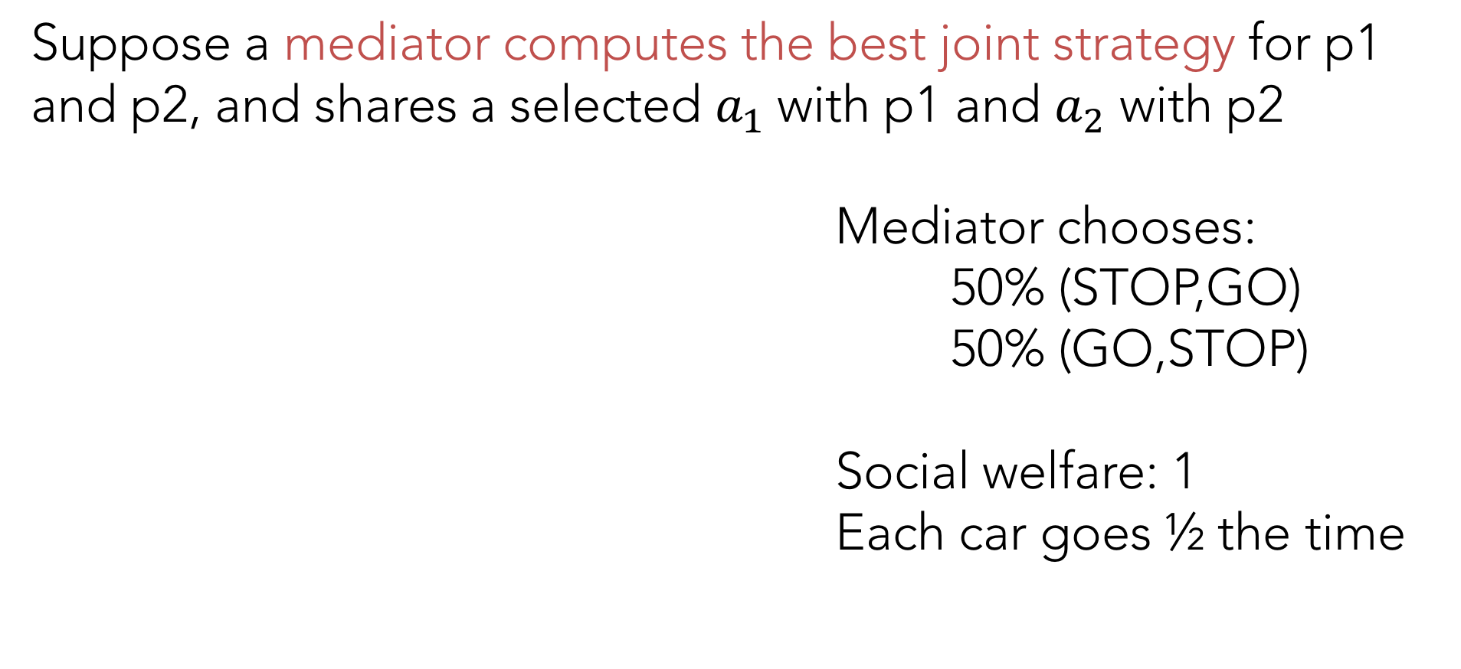
Correlated Equilibrium
Suppose a mediator computes the best joint strategy for p1 and p2, and shares a selected $a_{1}$with p1 and $a_{2}$ with p2
Mediator chooses:
50% (STOP,GO)
50% (GO,STOP)
Social welfare: 1
Each car goes ½ the time
TRAFFIC |  | CAR 2
 |  | STOP | GO
CAR 1 | STOP | 0,0 | 0,1
 | GO | 1,0 | -100,-100

Slide 17
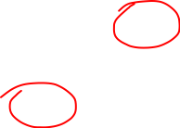
The Game of Chicken
PSNE:
CHICKEN |  | PERSON 2
 |  | CHICKEN | DARE
PERSON 1 | CHICKEN | 6,6 | 2,7
 | DARE | 7,2 | 0,0
Notes:
6q+2(1-q) = 7q
2-2q = q
2 = 3q
q = 2/3

Slide 18
The Game of Chicken
MSNE: Chicken 2/3, Dare 1/3 for each player
Utility: 4/9*6 + 2/9*2 + 2/9*7 + 1/9*0 = 42/9 = 4.667
CHICKEN |  | PERSON 2
 |  | CHICKEN | DARE
PERSON 1 | CHICKEN | 6,6 | 2,7
 | DARE | 7,2 | 0,0
Notes:
6q+2(1-q) = 7q
2-2q = q
2 = 3q
q = 2/3

Slide 19
The Game of Chicken
CE: Choose (C,C), (C,D), and (D,C) each with p=1/3
CHICKEN |  | PERSON 2
 |  | CHICKEN | DARE
PERSON 1 | CHICKEN | 6,6 | 2,7
 | DARE | 7,2 | 0,0

Slide 20
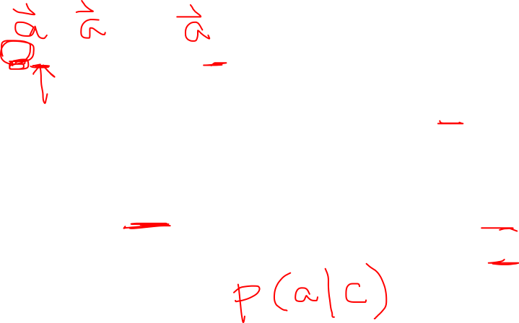
The Game of Chicken
CE: Choose (C,C), (C,D), and (D,C) each with p=1/3
If mediator tells P2 D,
he knows P1 plays C
If mediator tells P2 C,
½ the time P1 plays C
½ the time P1 plays D
CHICKEN |  | PERSON 2
 |  | CHICKEN | DARE
PERSON 1 | CHICKEN | 6,6 | 2,7
 | DARE | 7,2 | 0,0
Notes:
Look at the choices not the table

Slide 21

The Game of Chicken
CE: Choose (C,C), (C,D), and (D,C) each with p=1/3
If mediator tells P2 D,
he get U=7
If mediator tells P2 C,
½ the time U=6
½ the time U=2
CHICKEN |  | PERSON 2
 |  | CHICKEN | DARE
PERSON 1 | CHICKEN | 6,6 | 2,7
 | DARE | 7,2 | 0,0
Notes:
Expected utility of playing C is 4 instead of 3.5, so he should stay

Slide 22
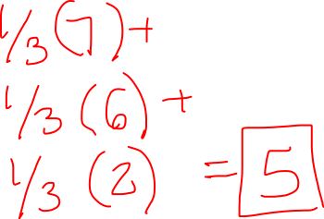
The Game of Chicken
CE: Choose (C,C), (C,D), and (D,C) each with p=1/3
Overall utility is
CHICKEN |  | PERSON 2
 |  | CHICKEN | DARE
PERSON 1 | CHICKEN | 6,6 | 2,7
 | DARE | 7,2 | 0,0
Notes:
Expected utility of playing C is 4 instead of 3.5, so he should stay

Slide 23
The Game of Chicken
CE: Choose (C,C), (C,D), and (D,C) each with p=1/3
Overall utility is 7/3+6/3+2/3 =
5 instead of 4.667
CHICKEN |  | PERSON 2
 |  | CHICKEN | DARE
PERSON 1 | CHICKEN | 6,6 | 2,7
 | DARE | 7,2 | 0,0
Notes:
Expected utility of playing C is 4 instead of 3.5, so he should stay

Slide 24
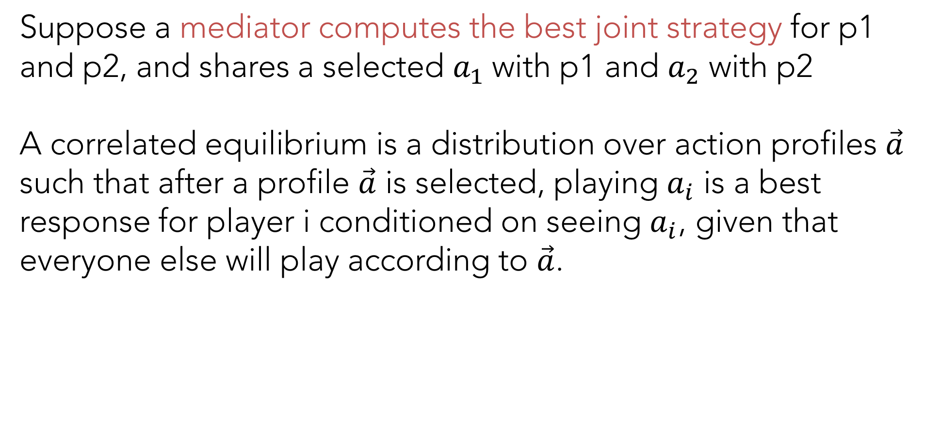
Correlated Equilibrium
Suppose a mediator computes the best joint strategy for p1 and p2, and shares a selected $a_{1}$with p1 and $a_{2}$ with p2
A correlated equilibrium is a distribution over action profiles $\vec{a}$ such that after a profile $\vec{a}$ is selected, playing $a_{i}$ is a best response for player i conditioned on seeing $a_{i}$, given that everyone else will play according to $\vec{a}$.

Slide 25
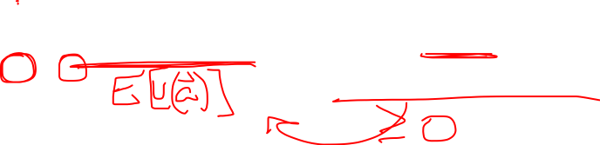
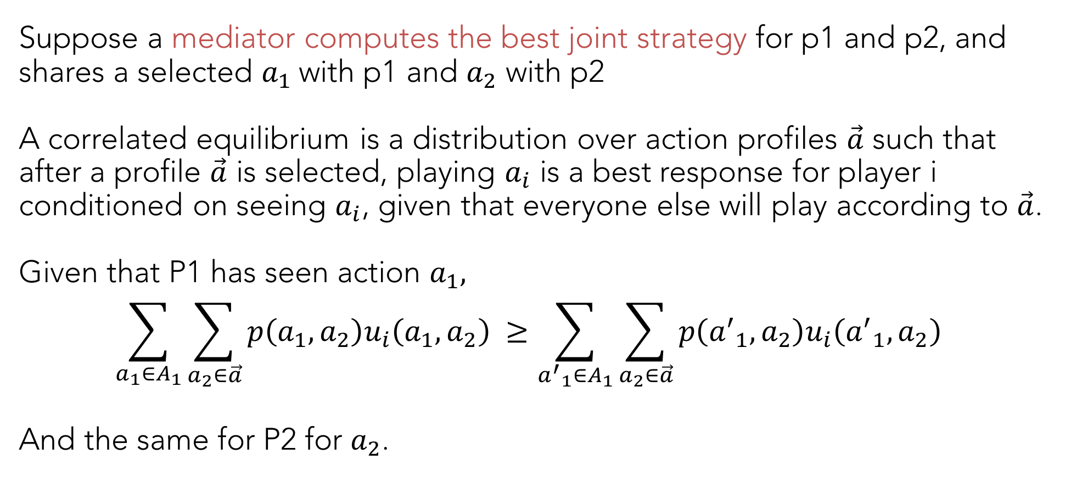
Correlated Equilibrium
Suppose a mediator computes the best joint strategy for p1 and p2, and shares a selected $a_{1}$with p1 and $a_{2}$ with p2
A correlated equilibrium is a distribution over action profiles $\vec{a}$ such that after a profile $\vec{a}$ is selected, playing $a_{i}$ is a best response for player i conditioned on seeing $a_{i}$, given that everyone else will play according to $\vec{a}$.
Given that P1 has seen action $a_{1},$
$${\sum_{a_{1}∈A_{1}}{\sum_{a_{2}∈\vec{a}}{p\left(a_{1},a_{2}\right)u_{i}\left(a_{1},a_{2}\right)}}}_{ }≥{\sum_{{a^{′}}_{1}∈A_{1}}{\sum_{a_{2}∈\vec{a}}{p\left({a^{′}}_{1},a_{2}\right)u_{i}\left({a^{′}}_{1},a_{2}\right)}}}_{ }$$
And the same for P2 for $a_{2}$.

Slide 26
AI: Representation and Problem Solving
Social Choice
Instructors: Pat Virtue & Stephanie Rosenthal
Slide credits: Ariel Procaccia

Slide 27
Social Choice
Mathematical theory that deals with the aggregation of individual preferences
Origins in Ancient Greece
Formal foundations in 18th century – Condorcet and Borda
19th Century – Charles Dodgson
20th Century – Nobel prizes to Arrow and Sen

Slide 28
Voting Model
Set of N voters {1,2,…,N}
Set of A alternatives: |A| = m
Each voter has a ranking of alternatives
Preference profile: collection of all voter rankings
1 | 2 | 3
a | b | a
b | c | c
c | a | b

Slide 29
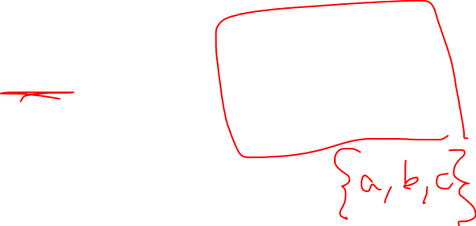
Voting Model
Set of N voters {1,2,…,N}
Set of A alternatives: |A| = m
Each voter has a ranking of alternatives
Preference profile: collection of all voter rankings
Voting rule: a function from a preference profile to an alternative (winner) of an election
1 | 2 | 3
a | b | a
b | c | c
c | a | b

Slide 30

Voting Rule: Plurality
Each voter gets one vote for their top-ranked preference.
Alternative with the most votes wins
1 | 2 | 3
a | b | a
b | c | c
c | a | b

Slide 31
Voting Rule: Plurality
Each voter gets one vote for their top-ranked preference.
Alternative with the most votes wins
a: 2 votes
b: 1 vote
1 | 2 | 3
a | b | a
b | c | c
c | a | b

Slide 32
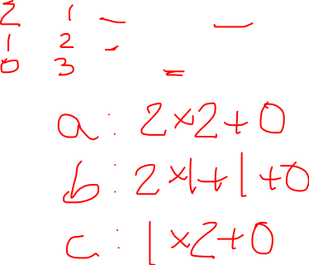
Voting Rule: Borda Count
Each voter awards m-k points to their rank k.
Alternative with the most votes wins
Used in elections in Slovenia and Eurovision singing contest
1 | 2 | 3
a | b | a
b | c | c
c | a | b

Slide 33
Voting Rule: Borda Count
Each voter awards m-k points to their rank k.
Alternative with the most votes wins
a: 2+0+2 = 4
b: 1+2+0 = 3
c: 0+1+1 = 2
1 | 2 | 3
a | b | a
b | c | c
c | a | b

Slide 34
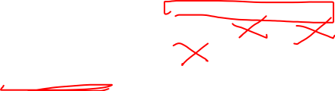
Voting Rule: Single Transferable Vote (STV)
Each voter gets 1 vote per round
In each round, alternative with the least number of plurality votes is eliminated
Alternative left standing is winner
Used in Ireland, Malta, Australia, NZ
1 | 2 | 3
a | b | a
b | c | c
c | a | b

Slide 35
Voting Rule: Single Transferable Vote (STV)
Each voter gets 1 vote per round
In each round, alternative with the least number of plurality votes is eliminated
Round 1: a and b survive
Round 2: a wins
1 | 2 | 3
a | b | a
b | c | c
c | a | b
1 | 2 | 3
a | b | a
b | a | b
1 | 2 | 3
a | a | a

Slide 36
Voting Rule: Single Transferable Vote (STV)
Each voter gets 1 vote per round
In each round, alternative with the least number of plurality votes is eliminated
Nothing to eliminate?
Tie breaking strategies include borda count, having the most last place votes, having the most votes in the first round, etc
1 | 2 | 3
a | b | c
b | c | b
c | a | a

Slide 37
On your own, rank your favorite candies
Crunch
M&Ms
Reese’s Cups
Snickers
Skittles
Milky Way
Almond Joy
Kit Kat

Slide 38
Compute the Plurality, Borda, STV winners
Crunch
M&Ms
Reese’s Cups
Snickers
Skittles
Milky Way
Almond Joy
Kit Kat

Slide 39
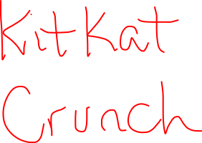
Plurality Winners

Slide 40
Borda Count Winners

Slide 41
STV Winners

Slide 42
What patterns do you notice?

Slide 43
Voting Rule: Pairwise Election
Alternative x beats y in pairwise election if majority of voters prefer x to y
1 | 2 | 3
a | b | a
b | c | c
c | a | b

Slide 44
Voting Rule: Pairwise Election
Alternative x beats y in pairwise election if majority of voters prefer x to y
2 voters prefer a over b
2 voters prefer b over c
2 voters prefer a over c
1 | 2 | 3
a | b | a
b | c | c
c | a | b

Slide 45
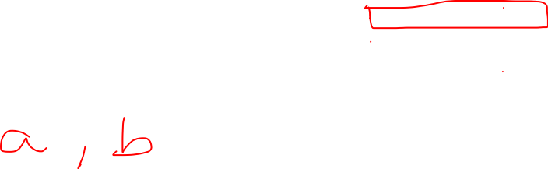
Voting Rule: Plurality with Runoff
First Round: Top 2 plurality winners advance to second round
Second Round: Pairwise election between two winners
1 | 2 | 3
a | b | a
b | c | c
c | a | b

Slide 46
Voting Rule: Plurality with Runoff
First Round: Top 2 plurality winners advance to second round
Second Round: Pairwise election between two winners
Round 1: a and b move on
Round 2: 2 votes for a over b
Alternative a wins
1 | 2 | 3
a | b | a
b | c | c
c | a | b

Slide 47
Voting Rule: Condorcet Winner
Alternative x beats y in pairwise election if majority of voters prefer x to y
Condorcet winner x beats every other alternative y in pairwise election
2 voters prefer a over b and a over c
Alternative a is the Condorcet winner
1 | 2 | 3
a | b | a
b | c | c
c | a | b

Slide 48
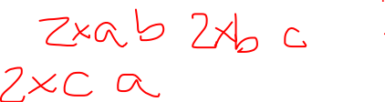
Voting Rule: Condorcet Winner
Alternative x beats y in pairwise election if majority of voters prefer x to y
Condorcet winner x beats every other alternative y in pairwise election
Condorcet paradox is a cycle in majority preferences
1 | 2 | 3
a | b | a
b | c | c
c | a | b
1 | 2 | 3
a | b | c
b | c | a
c | a | b

Slide 49
Poll 2
Condorcet consistent – voting rule selects a Condorcet winner if one exists
Which rule is always Condorcet consistent?
Plurality
Borda Count
Both
Neither

Slide 50
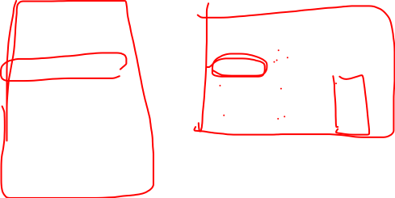
Poll 2
Condorcet consistent – voting rule selects a Condorcet winner if one exists
Which rule is always Condorcet consistent?
Plurality
Borda Count
Both
Neither
3 voters | 2 voters
a | b
b | c
c | a
3 voters | 2 voters | 2 voters
a | b | c
b | c | b
c | a | a
Plurality: a
Borda: b
Condorcet: a
Plurality: a
Borda: b
Condorcet: b
Notes:
Plurality: A
Borda: B
A: 6, B: 9, C: 6
Condorcet: B
B over A: 4
B over C: 5

Slide 51
Compute Plurality w/Runoff, Condorcet Winners
Crunch
M&Ms
Reese’s Cups
Snickers
Skittles
Milky Way
Almond Joy
Kit Kat

Slide 52
Plurality with Runoff Winners

Slide 53
Condorcet Winners

Slide 54
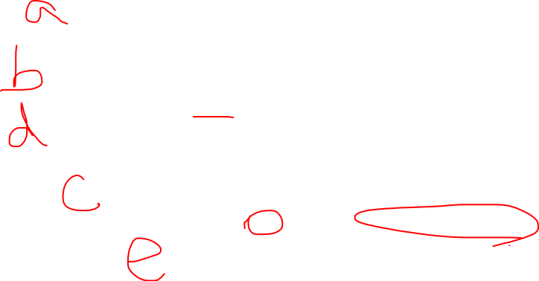
Fun Example
Plurality:
Borda:
STV:
Condorcet:
Plurality with runoff:
33 voters | 16 voters | 3 voters | 8 voters | 18 voters | 22 voters
a | b | c | c | d | e
b | d | d | e | e | c
c | c | b | b | c | b
d | e | a | d | b | d
e | a | e | a | a | a
Notes:
Plurality: a
Borda:b
STV: d
Condorcet: c
Plurality with runoff: e

Slide 55
Voting for Truth
Condorcet [1785]: the purpose of voting is not merely to balance subjective opinions but also a quest to find truth
Enlightened voters try to judge which alternatives best serve society
This is realistic in trials by jury, pooling expert opinions, and human computation

Slide 56

Crowdsourcing Molecule Designs
Participants solve puzzles to find molecule designs
They vote on which 8 designs get synthesized, the votes aim to compare designs by true quality
Developed by Adrien Treuille (CMU) and Stanford in 2010

Slide 57
Voting in Crowdsourcing
Amazon’s Mechanical Turk (started in 2005)
Organizations can post HITs (Human Intelligence Tasks) for small amounts of money
e.g. identify content in image/video, write product description, or answer questions/surveys, etc

Slide 58
Common HIT Frameworks
An organization poses a question with a single right (but unknown) answer
Voting : They actually post the same question N times (often N=5). If a majority of the responses are the same, they can ensure that it is good/correct. They post more times if responses do not yield a majority.

Slide 59
Common HIT Frameworks
An organization poses a question with a single right (but unknown) answer
An organization poses a question with many answers and collect N responses
Voting: Once many responses are collected, they pose a new HIT asking new participants to a) pairwise rank responses, b) rank all responses for the best answer

Slide 60
How to rank many responses
[Mao, Procaccia, Chen 2013]
Compared ranking strategies Plurality, Borda, Condorcet
Found that Borda finds the winners most consistently even with noisy human responses, Plurality performs the worst
What are the consequences of this finding?

Slide 61
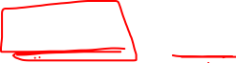
reCaptcha
Show participants 1 known and 1 unknown image
If they get the known one correct, assume unknown one is also reasonable
If 6 people request new, assume unreadable
Majority response wins (N=5)

Slide 62
Summary
Vocabulary
Voting rules – Plurality, Borda Count, STV, Pairwise election, Condorcet winner, Plurality with runoff
Crowdsourcing and Human Computation

